Slide 1

Name | ID
Mina Morkos Mikhael | 20180303
Omar Shokry Mohamed | 20180177
Mayar El-hussieny Mohamed | 20180148
Esraa Ahmed El-Sayed | 20180041
Abdelrahman Mohamed Soliman | 20180148
Supervised By:
Dr. Ali Zidane
TA. Mona Khamis
TA. Nesma Mostafa
Graduation Project
Academic Year 2021-2022
Mid-Year Presentation

Slide 2
Presentation Overview
Project Idea
Problem Significance
Project Specifications
Time Plan
Conclusion

Slide 3
Project Idea
Project idea and domain of interest

Slide 4
Motivation
staying at home is very difficult as everyone has his own work which has to be done so people has to go for their works and get mixed with each other.
This makes the number of infected people increases exponentially and increases number of death cases.
Our application allows each user to know level of risk in his current position using the map of the current location and shows the closest infected cases to the user to take care about himself.
Domain of interest:
Information Systems.
Software Engineering.

Slide 5
Problem Significance
Problem definition, previous solutions and suggested solution.

Slide 6
Problem definition
Everyone have to go everywhere to do their works without taking care to if they are surrounded by infected people or not so it increases number of infected people exponentially.
Also when the symptoms appear on someone, he doesn’t care as he thinks that he catches a cold and ignore it.
Some people also do not care about preventions to protect themselves.

Slide 7
Suggested solution
Our application aims to:
Helps user to know the risk in his current location.
Helps user to know the level of risk in any destination location he wants to know.
Makes user specify his current medical situation (infected or not).
Makes user get a preliminary insight about his medical status by doing an exercise.
Allows user to keep updated with the numbers of the infected cases.
Allows user to get an idea about symptoms and preventions of the Covid-19.

Slide 8
Related work
NHS COVID-19:
Is the official contact tracing app for England and Wales.
It lets you know the level of coronavirus risk in your postcode district.
It finds out when you’ve been near other app users who have since tested positive for coronavirus using QR code.
its disadvantage is that the user has to scan the QR code of every place he visits.
Co-WIN:
Is a search vaccination center which helps everyone in India to get vaccinated .
It suggests each user the nearest vaccination center by map, pin, or district.
It has a limited goal which is only for getting vaccinated.

Slide 9
Project Specification
Project specification and details

Slide 10
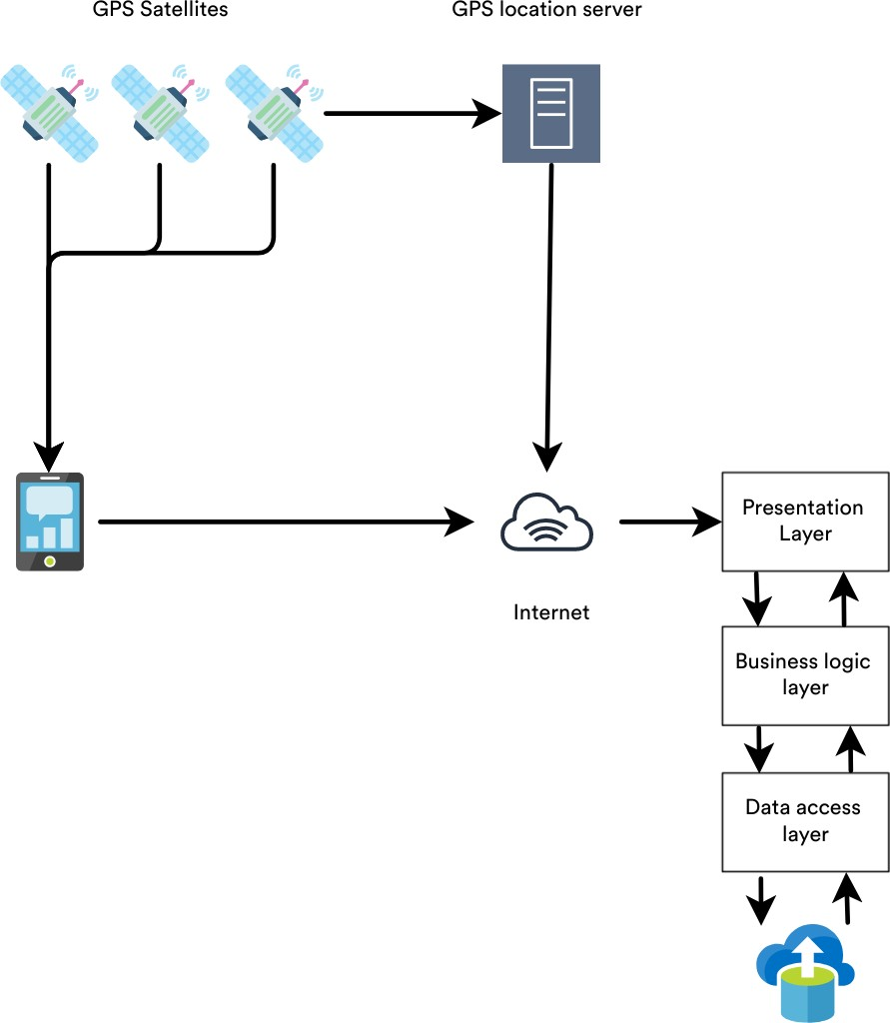
System Architecture

Slide 11
Stakeholders
Users.
Citizens
Age: 15-60.
Education: Intermediate.
Mobile experience: Intermediate.
Ministry of Health.

Slide 12
Functional Requirements
Function Name | Description
Check infected | It will ask user to specify his current medical status.
Detect current location | It will show a map for user with his current location and display if he is in a safe area or not.
Detect destination | User will detect the destination he want to go.
Detect destination risk | It will detect destination risk for the user.
Update map | System updates map when detecting a new infected case.
Display WHO questions | It acts like a test for each user to get preliminary insights about his current health situation.
Display cases | It displays current status for infected, recovered and death cases.
Update cases | It updates cases.
Display symptoms | It displays symptoms that user should be aware of.
Display preventions | It displays preventions that user should.

Slide 13
Non-Functional Requirements
Name | Description
Usability | Application interface is highly usable which makes the application easy-to-learn and easy-to-use by users. Interface behaves similar to other very-known applications such as uber and google maps in menu format, color schemes, etc. Usability Features Persistent navigation. Presentation and content. Color theory. Memory Recognition. Design principles. Feedback. Affordance.
Security | Flutter provides various security and authentication plugins. By integrating a sign-in plugin, developers can easily add an authentication check in an app. It also offers a secure data storage plugin named NSUserDefault for IOS and SharedPreferences for Android.

Slide 14
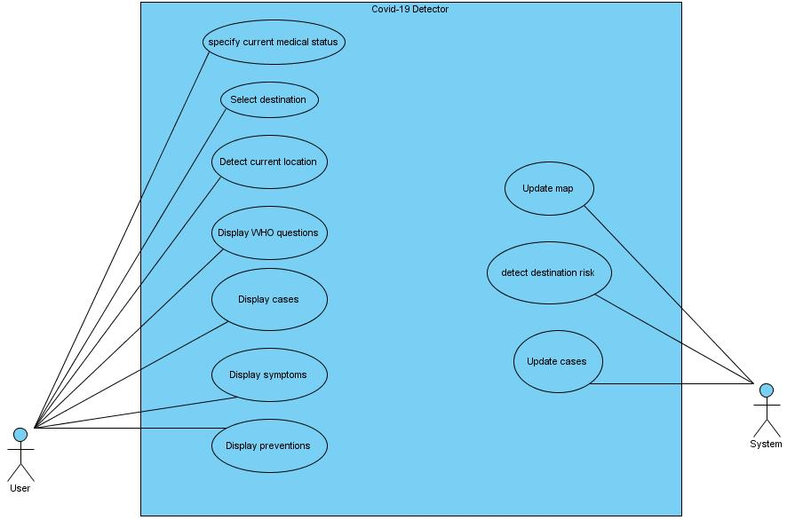
Use-case Diagram

Slide 15
Specify current medical status Select destination
Use case ID | 1
Use case name: | Specify current medical status.
Brief description: | User detects his current medical status (infected or not).
Actor: | User.
Related use case | Update map
Pre-conditions: | User must be logged in.
Post-conditions: | If he is infected the system will show him as an infected case for other people to be far from him.
Flow of activities: | User | System
 | User select his medical state, | System updates map for other users.
Use case ID | 2
Use case name: | Select destination
Brief description: | User detects the destination that he wants to know the level of risk there.
Actor: | User.
Related use cases: | Detect destination risk.
Pre-conditions: | GPS is on and user is logged in.
Post-conditions: | The system will show the user level of risk in the selected destination
Flow of activities: | User | System
 | User select destination. | System detects destination risk. System shows level of risk.

Slide 16
Detect current location Display WHO questions
Use case ID | 3
Use case name: | Detect current location
Brief description: | User can see for his current location the nearest infected cases.
Actor: | User.
Pre-conditions: | GPS is on and user is logged in.
Post-conditions: | The system will show the infected cases around the user.
Flow of activities: | User | System
 | Opens map to see his current location. | System shows nearest infected cases around the user.
Use case ID | 4
Use case name: | Display WHO questions
Brief description: | User does an exam test to get a preliminary insight about his medical status.
Actor: | User.
Pre-conditions: | user is logged in.
Post-conditions: | The system will show the user level of risk in the selected destination
Flow of activities: | User | System
 | User selects to do the test. | System shows test questions and displays the result after the user ends the test.

Slide 17
Display symptoms Display cases
Use case ID | 5
Use case name: | Display symptoms.
Brief description: | User wants to get an idea about virus symptoms.
Actor: | User.
Pre-conditions: | User is logged in.
Post-conditions: | The system will show symptoms of the virus.
Flow of activities: | User | System
 | User select symptoms. | System shows symptoms.
Use case ID | 6
Use case name: | Display cases.
Brief description: | User wants to see current pandemic statistics.
Actor: | User.
Related use cases: | Update cases.
Pre-conditions: | User is logged in.
Post-conditions: | The system will show current pandemic statistics.
Flow of activities: | User | System
 | User selects pandemic statistics. | System updates cases. System shows pandemic statistics.

Slide 18
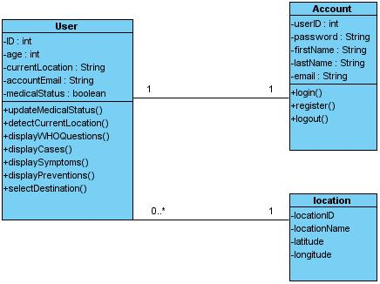
Class Diagram

Slide 19
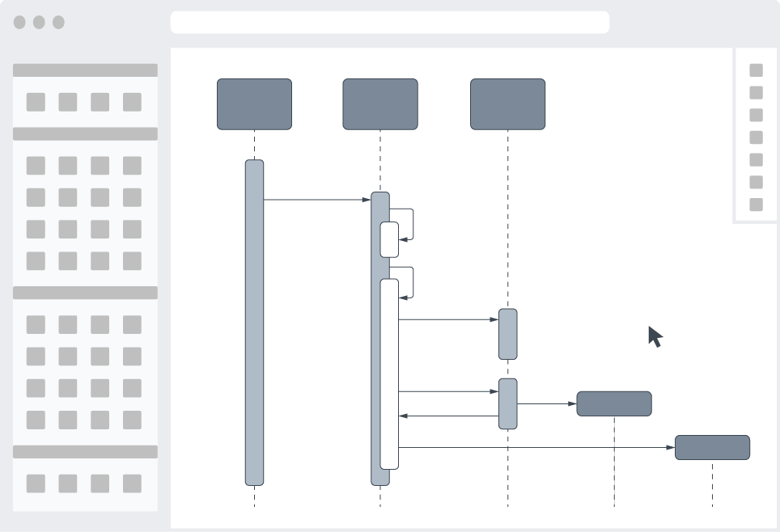
Sequence Diagram

Slide 20
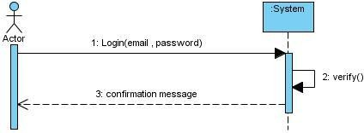
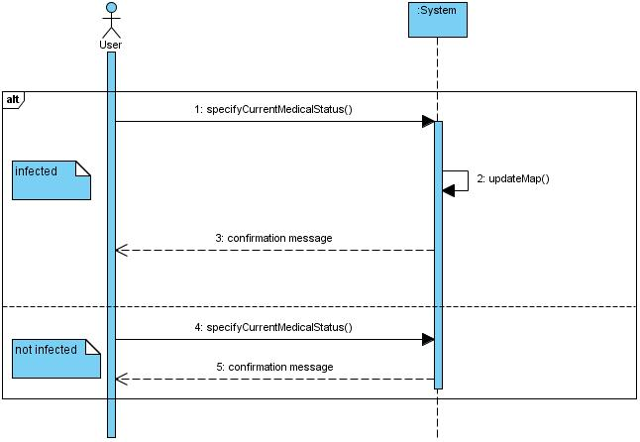
Login Sequence Diagram Specify current medical status

Slide 21
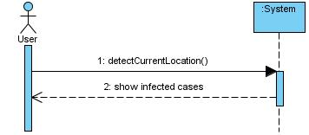
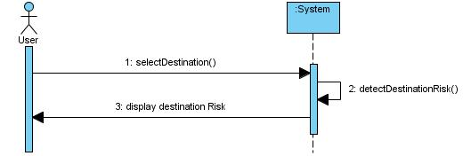
Detect current location Select destination

Slide 22
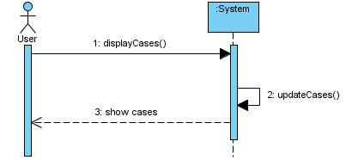
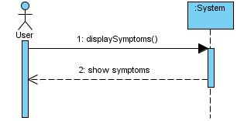
Display cases Display symptoms

Slide 23
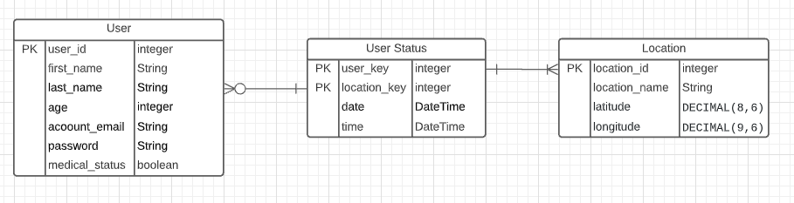
ERD

Slide 24

Prototype

Slide 25
Time Plan
Plan for previous and next four months

Slide 26
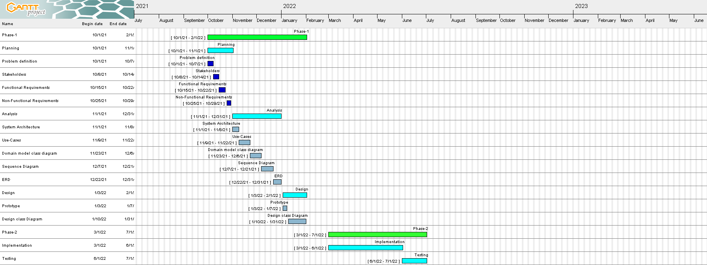
Gantt Chart

Slide 27
Previous four months
Task | Task Name | Description | Task Status
1 | Problem Definition | Identify the problem and document the objective of the solution system. | Completed
2 | Stakeholders | Define persons who have an interest in the successful implementation of the system. | Completed
3 | Functional Requirements | Identify activities that the system must perform to support user’s work. | Completed
4 | Non-Functional Requirements | Identify required system characteristics other than the activities it must perform. | Completed
5 | System Architecture | Define system overall architecture. | Completed
6 | Use-cases | Identifying the activities that a system must perform in response to a request by a user. | Completed
7 | Class Diagram | Identifying classes included in the problem | Completed
8 | Sequence Diagram | Diagramming the sequence of messages between actor and system. | Completed
9 | ERD | Define entities, their attributes and their relationships. | Completed
10 | Prototype | Making a demo of the application | Completed

Slide 28
Next four months
Task | Task Name | Description | Task Status
1 | Implementation | Actual implementation of the application. | Incomplete
2 | Testing | Perform unit and integration testing. | Incomplete

Slide 29
Conclusion
Covid Detector is an application for tracking the movement of each user and detect the level of risk in his current location or any other destination he wants to go.
Covid Detector also provides guidelines, preventions and test questions for a preliminary insight about each user’s current medical status.

Slide 30


